Slide 1
BE 1600 Introduction to Programming and Computation Fall Term 2022 Midterm Exam

Slide 2
Exam Date
For students in Lab sections 2 and 3 (Tuesday's Labs)
Tuesday (10/18/2022) at lab time
For students in Lab sections 4 and 5 (Thursday’s Labs)
Thursday (10/20/2022) at lab time
Two parts:
Part 01 (Multiple-choice) begins at 10:30 A.M. and end at 11:20 A.M.
Part 02 (Programming) begins at 11:20 A.M. and end at 12:20 P.M.
If you completed part 1 before time expired, you must wait in class until part 2 begins.

Slide 3
Exam Instructions
Closed Book
Part 01 : 30 Multiple-Choice Questions (120 points)
Part 02: two-programming questions (30 points)
Both parts will be taken on Canvas
Exam requiers Respondus LockDown Browser software
There will be No make-up Exam (NO EXCEPTION)

Slide 4
What to Study?
Four chapters
Chapter 1: Introduction to Computers, Programs, and Python
Chapter 2: Elementary Programming
Chapter 3: Selections
Chapter 4 Loops

Slide 5
Chapter 1 Introduction to Computers, Programs, and Python

Slide 6
Programming Languages
Machine Language Assembly Language High-Level Language
Machine language is the language of a computer. It is a sequence of 0s and 1s. The digit 0 or 1 is called a binary digit.
Early computers were programmed in machine language.
To calculate wages = rate * hours in machine language:
100100 010001 //Load
100110 010010 //Multiply
100010 010011 //Store

Slide 7
Programming Languages
Machine Language Assembly Language High-Level Language
The high-level languages are English-like and easy to learn and program.
For example, the following is a high-level language statement that computes the wages:
wages = rate * hours;

Slide 8
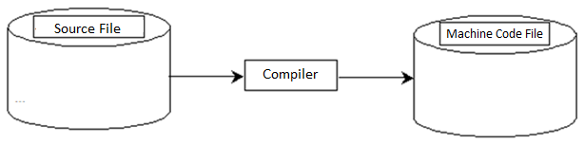
Compiling Source Code
A program written in a high-level language is called a source program.
Since a computer cannot understand a source program, a program called a compiler is used to translate the source program into a machine language program.

Slide 9
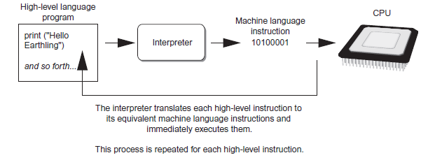
What is Python?
General Purpose Interpreted Object-Oriented
Python is interpreted, which means that python code is translated and executed by an interpreter one statement at a time.
In a compiled language, the entire source code is compiled and then executed altogether.

Slide 10
Chapter 2 Elementary Programming

Slide 11
Displaying Multiple Items with the print Function
Python allows one to display multiple items with a single call to print
Items are separated by commas when passed as arguments
Arguments displayed in the order they are passed to the function
Items are automatically separated by a space when displayed on screen

Slide 12
Numeric Data Types, Literals, and the str Data Type
Data types:
e.g., int for integer, float for real number, str used for storing strings in memory

Slide 13
Strings and String Literals
String: sequence of characters that is used as data
String literal: string that appears in actual code of a program
Must be enclosed in single (‘) or double (“) quote marks
String literal can be enclosed in triple quotes (''' or """)
Enclosed string can contain both single and double quotes and can have multiple lines

Slide 14
Numeric Literals
Numeric literal: number written in a program
No decimal point considered int, otherwise, considered float
Some operations behave differently depending on data type
Examples:
integer: e.g., 3, 4
float: e.g., 3.0, 4.0

Slide 15
Variables
Variable: name that represents a value stored in the computer memory
Used to access and manipulate data stored in memory
A variable references the value it represents
Assignment statement: used to create a variable and make it reference data
General format is variable = expression
Example: age = 29
Assignment operator: the equal sign (=)

Slide 16
Variable Naming Rules
Rules for naming variables in Python:
Variable name cannot be a Python key word
Variable name cannot contain spaces
First character must be a letter or an underscore
After first character may use letters, digits, or underscores
Variable names are case sensitive
Variable name should reflect its use

Slide 17
Reading Input from the Keyboard
Most programs need to read input from the user
Built-in input function reads input from keyboard
Returns the data as a string
Format: variable = input(prompt)
prompt is typically a string instructing user to enter a value
Does not automatically display a space after the prompt

Slide 18
Reading Input from the Keyboard (cont’d.)
input function always returns a string
Built-in functions convert between data types
int(item) converts item to an int
float(item) converts item to a float
Nested function call: general format: function1(function2(argument))
value returned by function2 is passed to function1
Type conversion only works if item is valid numeric value, otherwise, generates an error

Slide 19
Numeric Operators

Slide 20
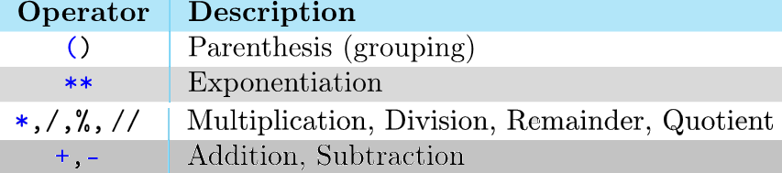
Order of Operations (cont’d.)

Slide 21
Mixed-Type Expressions and Data Type Conversion
Data type resulting from math operation depends on data types of operands
Two int values: result is an int
Two float values: result is a float
int and float: int temporarily converted to float, result of the operation is a float
Type conversion of float to int causes truncation of fractional part

Slide 22
Augmented Assignment Operators
Operator Example Equivalent
+= i += 8 i = i + 8
-= f -= 8.0 f = f - 8.0
*= i *= 8 i = i * 8
/= i /= 8 i = i / 8
//= i //= 8 i = i // 8
%= i %= 8 i = i % 8

Slide 23
Printing without the Newline
print function displays line of output
Newline character at end of printed data
Special argument end=‘delimiter’ causes print to place delimiter at end of data instead of newline character
print function uses space as item separator
Special argument sep=‘delimiter’ causes print to use delimiter as item separator

Slide 24
Escape Sequences for Special Characters (cont’d.)
Description Escape Sequence
Tab \t
Linefeed \n
Backslash \\
Single Quote \'
Double Quote \"

Slide 25
Format Method
format is a method that creates a new string where certain elements of the string are formatted.
To understand string formatting, it is probably better to start with an example.
print("Sorry, is this the {} minute{}?". format(5, 'ARGUMENT'))
prints Sorry, is this the 5 minuteARGUMENT

Slide 26
Programming Errors
Syntax Errors
Error in code construction
Runtime Errors
Causes the program to abort
Logic Errors
Produces incorrect result

Slide 27
Chapter 3 Selections

Slide 28
Relational Operators
Operator Name
< less than
<= less than or equal to
> greater than
>= greater than or equal to
== equal to
!= not equal to

Slide 29
One-way if Statements
if radius >= 0:
area = radius * radius * 3.14159
print("The area for the circle of radius“,
radius, "is“, area)
if boolean-expression:
statement(s)

Slide 30
The Two-way if-else Statements
if boolean-expression:
statement(s)-for-the-true-case
else:
statement(s)-for-the-false-case

Slide 31
Generating Random Numbers
Random number are useful in a lot of programming tasks
random module: includes library functions for working with random numbers
Dot notation: notation for calling a function belonging to a module
Format: module_name.function_name()

Slide 32
Generating Random Numbers (cont’d.)
randint function generates a random number in the range provided by the arguments
random function: returns a random float in the range of 0.0 and 1.0
Does not receive arguments
uniform function: returns a random float but allows user to specify range

Slide 33
Logical Operators

Slide 34
Operator Precedence
**
not
*, /, //, %
+, -
<, <=, >, >=
==, !=
and
or
=, +=, -=, *=, /=, //=, %= (Assignment operator)

Slide 35
Chapter 4 Loops

Slide 36
while Loop Flow Chart
count = 0
while count < 100:
print("Programming is fun!")
count = count + 1
while loop-continuation-condition:
# Loop body
Statement(s)

Slide 37
Ending a Loop with a Sentinel Value
Often the number of times a loop is executed is not predetermined. You may use an input value to signify the end of the loop. Such a value is known as a sentinel value.
data = int(input("Enter an integer (the input exits " + "if the input is 0): "))
# Keep reading data until the input is 0
sum = 0
while data != 0:
sum += data
data = int(input("Enter an integer (the input exits " + "if the input is 0): "))
print("The sum is", sum)

Slide 38
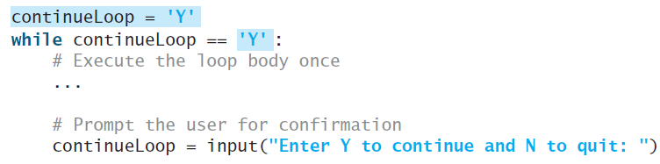
Controlling a Loop with User Confirmation
If you want the user to decide whether to take another question, you can offer a user confirmation. The template of the program can be coded as follows:

Slide 39
Using break and continue
Examples for using the break and continue keywords:
sum = 0
number = 0
while number < 20:
number += 1
sum += number
if sum >= 100:
break
print("The number is", number)
print("The sum is", sum)
The number is 14
The sum is 105
sum = 0
number = 0
while number < 20:
number += 1
if number == 10 or number == 11:
continue
sum += number
print("The sum is", sum)
Test Break
Test Continue

Slide 40
for Loops
i = initialValue # Initialize loop-control variable
while i < endValue:
# Loop body
...
i++ # Adjust loop-control variable
for i in range(initialValue, endValue):
# Loop body

Slide 41
for Loops
>>> for i in range(4):
... print(i)
...
0
1
2
3
>>>
>>> for v in range(4, 8):
... print(v)
...
4
5
6
7
>>>
>>> for v in range(3, 9, 2):
... print(v)
...
3
5
7
>>>

Slide 42
Nested Loops
Problem: Write a program that uses nested for loops to print a multiplication table.

Slide 43


Accumulator Pattern
Used to compute a running sum
Define and initialize an accumulator variable
In a loop, add value to accumulator

